Slide 1
INTRODUCTION TO DATA SCIENCE
BY,
K.S.KEERTHANA
A.DANIEL RAJ

Slide 2
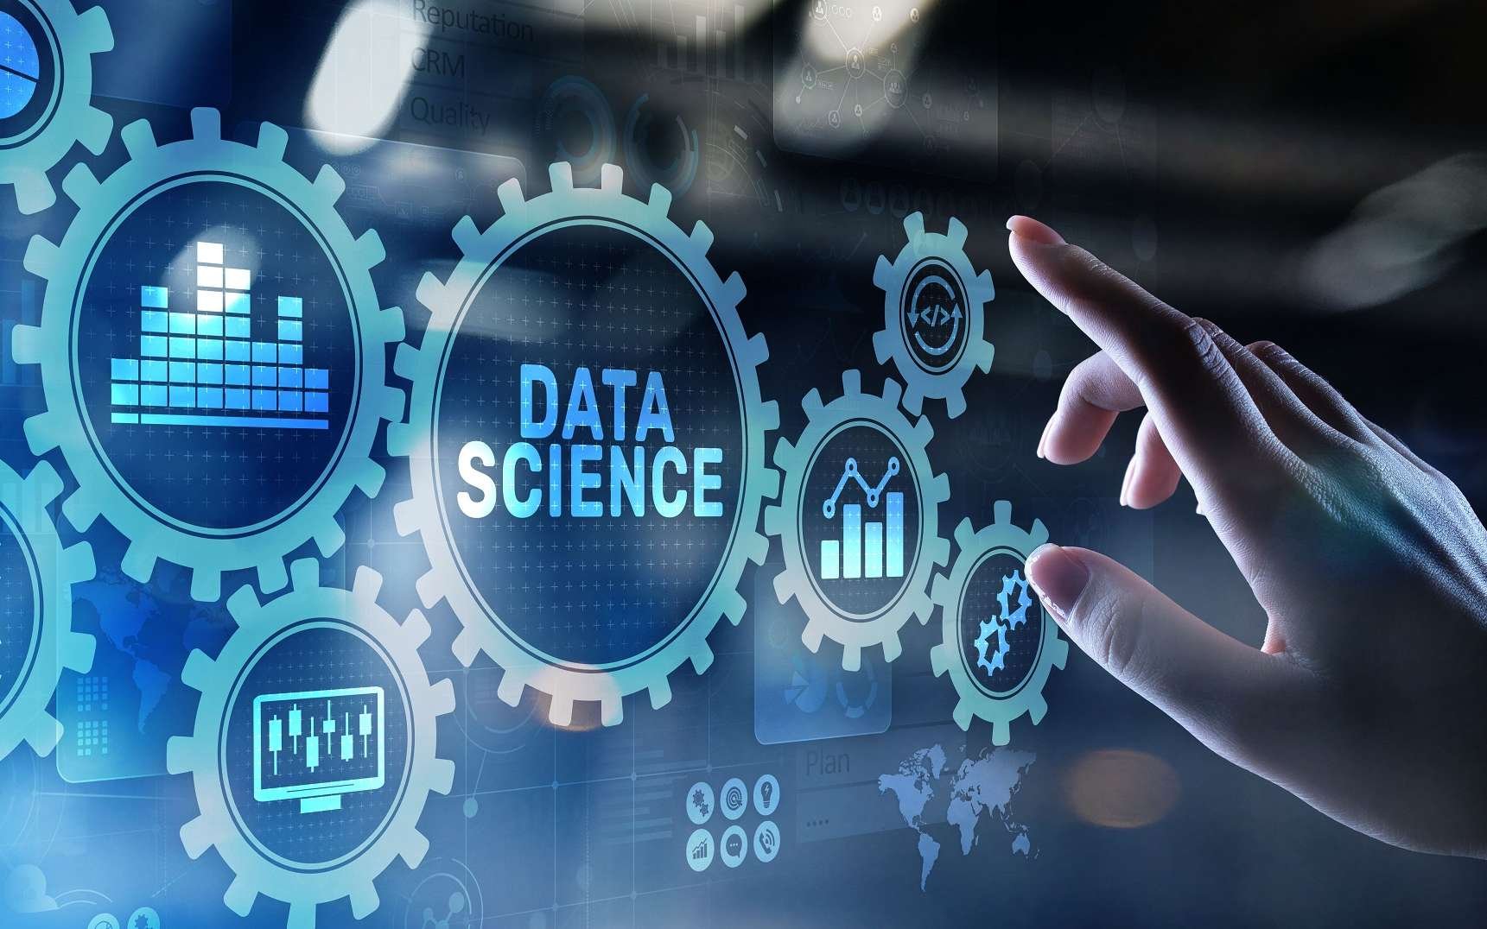
INTRODUCTION TO DATASCIENCE
Data science is the field that combines statistics, mathematics, programming, and domain-specific knowledge to extract insights and knowledge from data. It involves collecting, processing, analyzing, and interpreting complex data to solve real-world problems and drive informed decision-making.
The key components of Data Science include data mining, machine learning, data visualization, and statistical analysis, all aimed at deriving meaningful insights from data

Slide 3
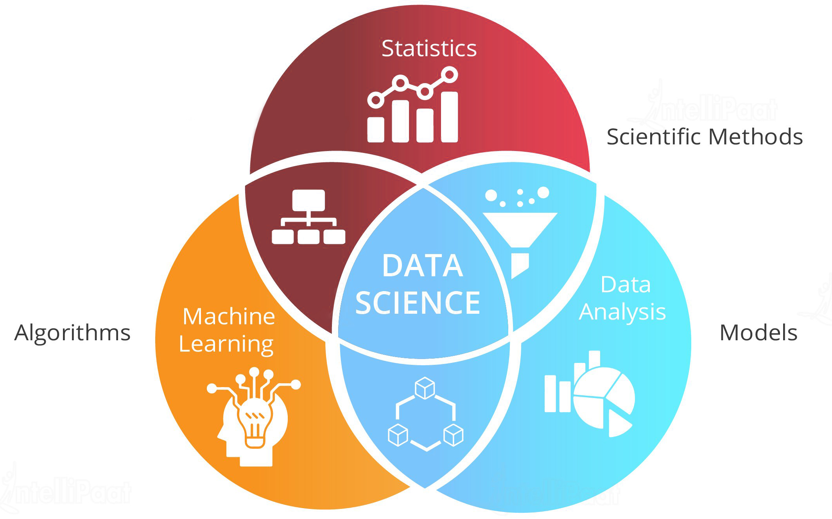
WHAT IS DATA SCIENCE?
Data science is a multi-disciplinary field that combines statistical analysis, machine learning, and domainspecific expertise to extract meaningful insights from complex data. It involves using advanced algorithms, tools, and techniques to gather, process, and interpret large datasets in order to drive informed decisionmaking and solve real-world problems.
At its core, data science focuses on uncovering patterns, trends, and anomalies within data that can lead to innovative solutions and strategic business advantages. Data scientists leverage their skills in mathematics, programming, and data manipulation to transform raw data into actionable intelligence that can be used to improve products, optimize operations, and enhance customer experiences.

Slide 4

MACHINE LEARNING IN DATA SCIENCE
Machine Learning and predictive modeling are fundamental techniques in Data Science, enabling the development of algorithms that can learn from and make predictions based on data.

Slide 5
DATA VISUALIZATION IN DATA SCIENCE
Data Visualization is a powerful tool for communicating insights and findings from data, allowing for clear and impactful storytelling.
Impactful Visuals
Thoughtfully crafted data visualizations captivate audiences, transforming complex information into engaging, easy-tounderstand narratives that drive meaningful insights.
Contextual Framing
Effective data storytelling situates analytics within a broader context, highlighting relevant trends, patterns, and connections to support informed decision-making.
Emotional Connection
By appealing to both logic and emotion, data storytellers can inspire action, foster empathy, and create lasting impressions that resonate with their audience.
Interactive Experiences
Dynamic data visualizations allow audiences to explore insights interactively, deepening engagement and enabling tailored discoveries based on individual interests and needs.

Slide 6
APPLICATIONS OF DATA SCIENCE
1.Personalized Recommendations:
Data science powers personalized product and content recommendations on platforms like Amazon, Netflix, and Spotify, enhancing user experiences.
2.Predictive Maintenance:
Analyzing sensor data can predict when equipment is likely to fail, allowing
for proactive maintenance and reduced downtime.
3.Fraud Detection:
Machine learning models can detect anomalies and patterns
indicative of fraudulent activities, protecting businesses and consumers.

Slide 7
DATA COLLECTION AND PREPROCESSING
Data Gathering
Feature Engineering
The first step is to identify relevant data sources and collect raw data, which can come from a variety of formats like databases, APIs, and web scraping.
The first step is to identify relevant data sources and collect raw data, which can come from a variety of formats like databases, APIs, and web scraping.
1
3
2
Data Cleaning
Next, the data must be cleaned by handling missing values, addressing inconsistencies, and ensuring data quality and integrity

Slide 8
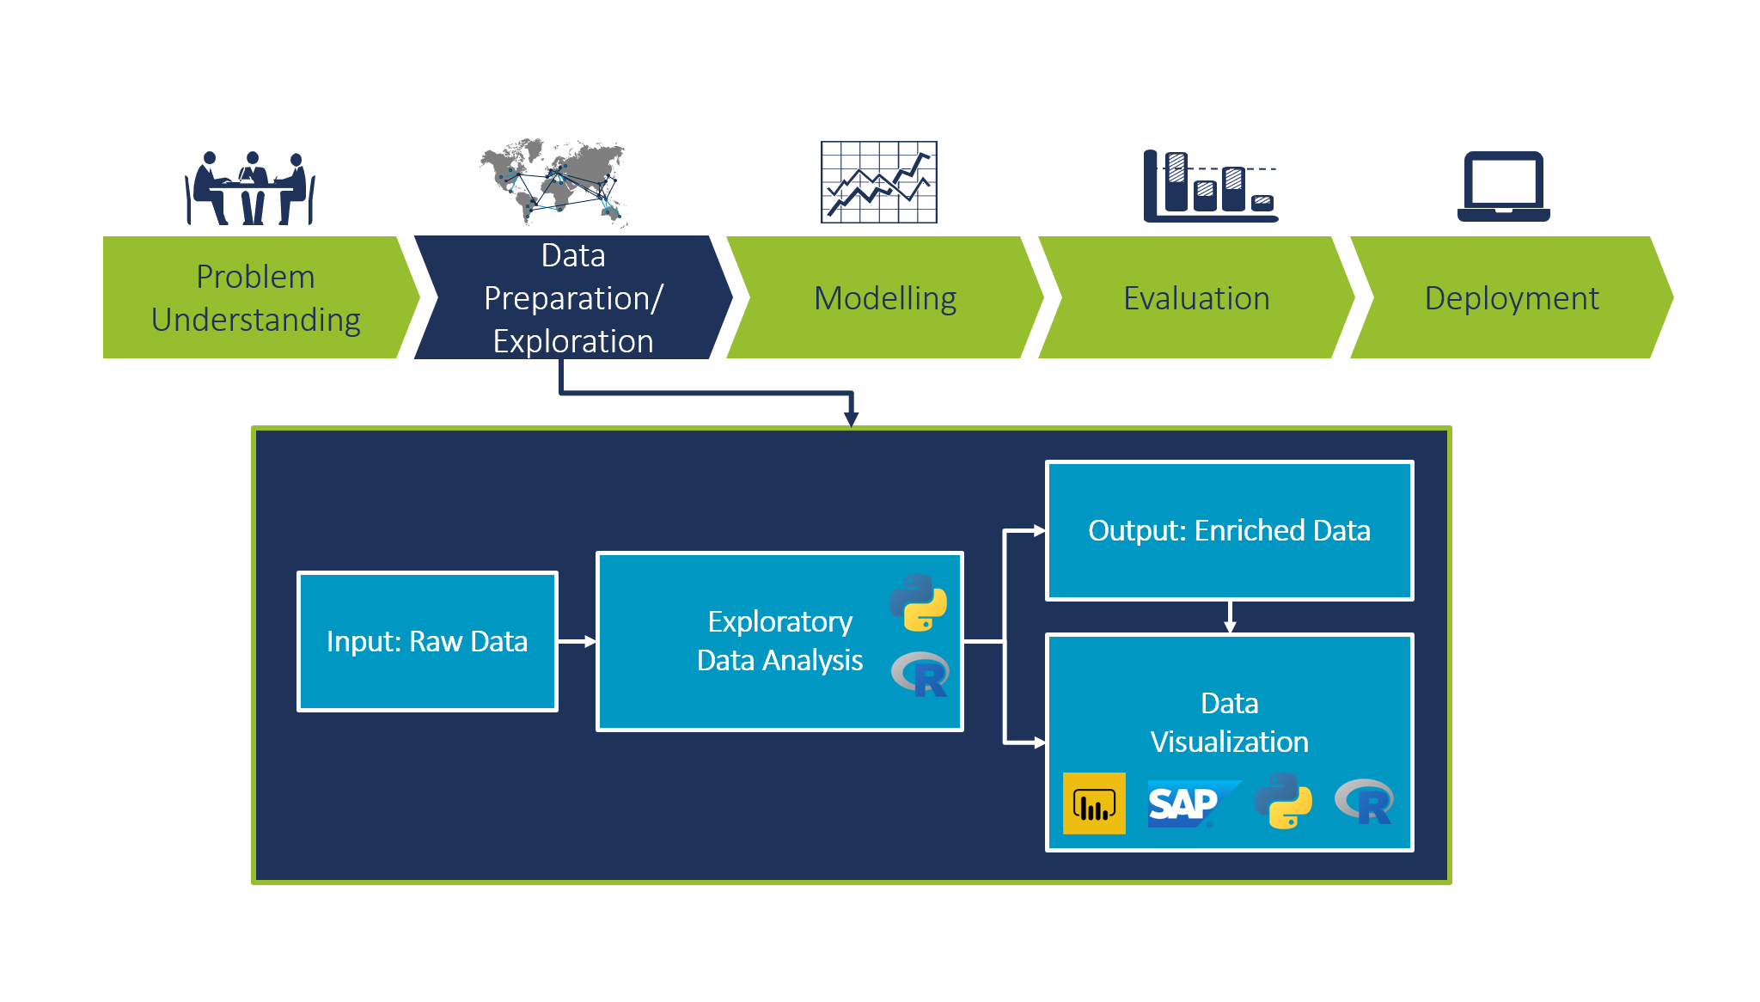
EXPLORATORY DATA ANALYTICS
Exploratory Data Analysis (EDA) is a crucial step in the data science process, where analysts dive deep into the dataset to uncover patterns, identify anomalies, and gain a comprehensive understanding of the data's structure and characteristics.
Through techniques like data visualization, statistical summaries, and hypothesis testing, EDA empowers data scientists to make informed decisions, formulate relevant questions, and lay the groundwork for more advanced analyses and modeling

Slide 9
STATISTICAL MODELLING
Regression Analysis
Time Series Analysis
Bayesian Statistics
Survival Analysis
Regression techniques like linear, logistic, and polynomial regression allow data scientists to model the relationship between dependent and independent variables, uncovering insights about how one variable affects another
Time series models analyze data points collected over time to identify trends, seasonality, and other patterns that can be used to make forecasts and predictions.
Bayesian methods use probability to update beliefs about unknown parameters as new data becomes available, providing a more flexible and intuitive approach to statistical inference.
Survival analysis techniques model the time it takes for an event to occur, such as the failure of a product or the onset of a disease, providing insights for risk assessment and decision-making

Slide 10
MACHINE LEARNING TECHNIQUES
Supervised Learning
Supervised learning algorithms are trained on labeled datasets to build predictive models that can classify data or forecast future outcomes.
Unsupervised Learning
Unsupervised learning techniques uncover hidden patterns and structures in unlabeled data, enabling the discovery of useful insights without prior assumptions.
Reinforcement Learning
Reinforcement learning trains models to take optimal actions in dynamic environments by learning through a system of rewards and penalties.
Deep Learning
Deep learning leverages multi-layered neural networks to autonomously extract high-level features and patterns from complex, unstructured data

Slide 11
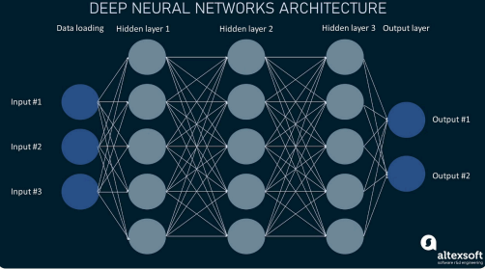
DEEP LEARNING AND NEURAL NETWORKS IN DATASCIENCE
Deep learning is a powerful branch of machine learning that utilizes multi-layered neural networks to extract intricate patterns from complex, unstructured data. These sophisticated algorithms can autonomously learn and improve through exposure to vast datasets, enabling remarkable feats in areas like computer vision, natural language processing, and predictive analytics.
Neural networks are inspired by the human brain, consisting of interconnected nodes that transmit signals between each other. As the network is exposed to more data, it dynamically adjusts the strength of these connections, allowing it to identify increasingly nuanced features and make more accurate predictions

Slide 12

CHALLENGES AND FUTURE TRENDS
As the field of Data Science continues to evolve, challenges such as data privacy and security will need to be addressed, while future trends may include advancements in AI and automation.

Slide 13

CONCLUSION
In conclusion, data science is a multifaceted field that plays a crucial role in extracting insights, making predictions, and driving decision-making processes across various industries.
Data science holds immense potential to drive innovation, solve complex problems, and generate value for businesses and society alike. By harnessing the power of data, organizations can gain actionable insights, optimize performance, and make informed decisions that lead to tangible outcomes and positive impact. As the field continues to evolve, the demand for skilled data scientists is expected to grow, making data science a compelling and rewarding career path for those passionate about leveraging data to drive positive change.

Slide 14
THANK YOU!

